Slide 1
Intermediate Education Ontology

Slide 2
Team Leader: Sehrish Noreen – BSEF19M014
Team Member: Rabia Ehsan – BSEF19M013
Team Member: Kiran Anwar – BSEF19M018

Slide 3
1. Ontology Introduction 2. Educational Domain Introduction 3. Mind-Mapping 4. Methodology 5. Tool and techniques

Slide 4
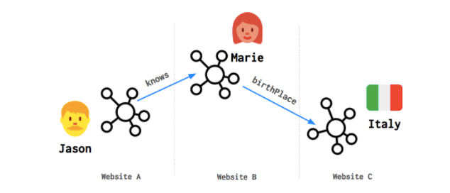
Ontology introduction:
Ontology is the basis for semantic web.
A knowledge network made up of linked data.
relationships or connections between data from different data sources such as databases and the Web.
Examples of large linked data sets are DBpedia and Wikidata.
FAIR:
F: Findable
A: Accessible
I: Interoperable
R: Reusable
https://wordlift.io/blog/en/entity/linked-data/

Slide 5
Ontology introduction:
Web 1.0 | Web 2.0 | Web 3.0
Web pages | Social web | Web of data
Read only | Read and write | Executable web
No interoperability | No interoperability | Interoperability

Slide 6
EDUCATIONAL DOMAIN INTRODUCTION:
Education
Primary
Middle
Matric
Intermediate
Under/Post
Graduate
1-5
6-8
9-10
13-->
11
12

Slide 7
EDUCATIONAL DOMAIN INTRODUCTION:
Example

Slide 8

Student

Slide 9

Takes_Admission_In
Student
College

Slide 10

Program
Offers
Takes_Admission_In
Student
College

Slide 11
Program
Enrolls_In
Offers
Takes_Admission_In
Student
College

Slide 12

Syllabus
Covers
Enrolls_In
Program
Offers
Takes_Admission_In
Student
College

Slide 13

BISE
Organizes
Syllabus
BISE Exam
Covers
Takes
Enrolls_In
Program
Offers
Takes_Admission_In
Student
College

Slide 14

BISE
Organizes
Syllabus
BISE Exam
Announces
Covers
Gives
Enrolls_In
Gets
Program
BISE Result
Offers
Takes_Admission_In
Student
College

Slide 15

BISE
Organizes
Syllabus
BISE Exam
Announces
Covers
Takes
Enrolls_In
Gets
Program
BISE Result
Offers
Takes_Admission_In
Student
Provides
College
Facilities

Slide 16
BISE
Organizes
Syllabus
BISE Exam
Announces
Covers
Takes
Enrolls_In
Gets
Program
BISE Result
Offers
Takes_Admission_In
Avails
Student
Provides
College
Facilities

Slide 17
BISE
Organizes
Syllabus
BISE Exam
Announces
Covers
Takes
Enrolls_In
Gets
Program
BISE Result
Offers
Takes_Admission_In
Avails
Student Name
Roll No.
Gender
Student
Provides
College
Facilities

Slide 18
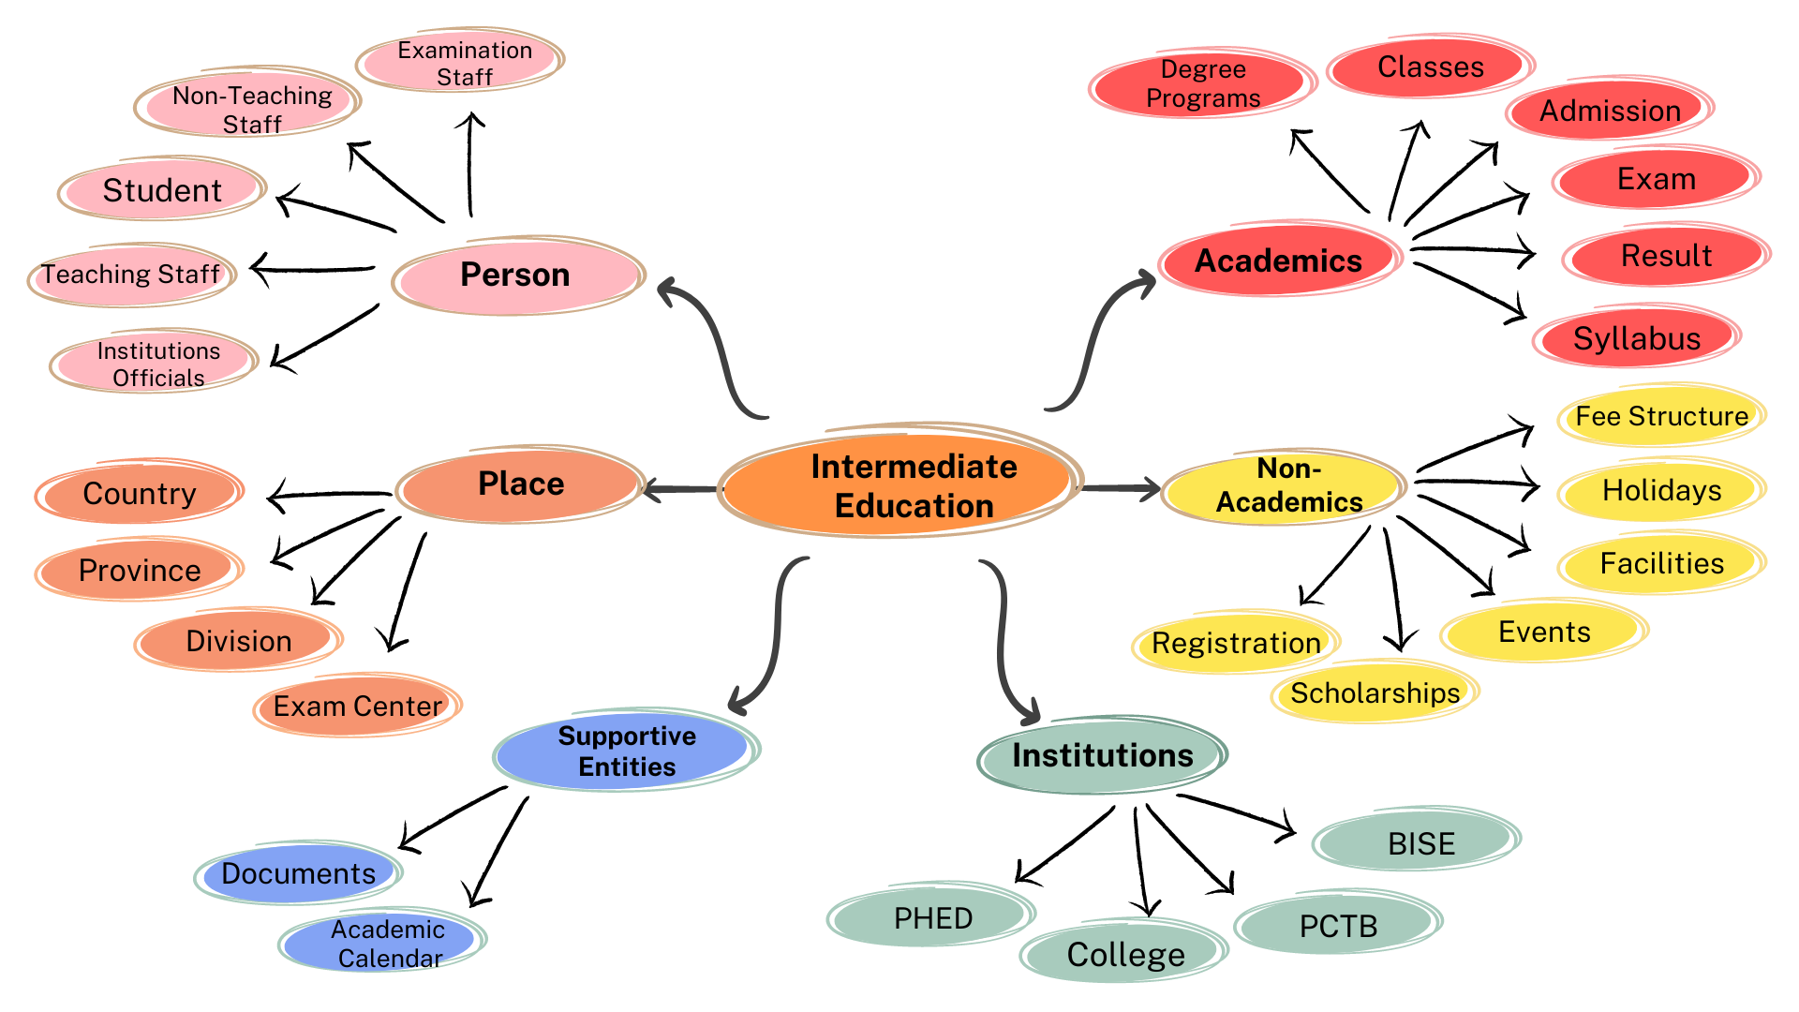
Mind-Mapping

Slide 19
Methodology:
Methodology is the sequence of steps we take to engineer/re-engineer our ontology.
Different methodologies are available for ontology engineering.
We will use NeON methodology.
It provides 9 scenarios for ontology engineering.
6-phase Iterative Incremental Life cycle model, includes following phases:
Initiation
Reuse
Reengineer
Design
Implementation
Maintain

Slide 20
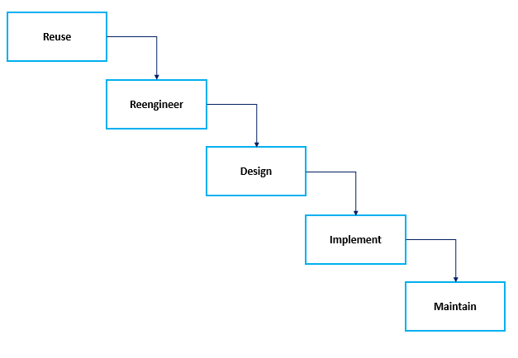
Iterative Incremental Life cycle model :
Initiation
Iteration 1
Iteration 2
Iteration 3

Slide 21
Motivation:
We are going to develop this ontology to clear the students’ queries about 2-year inter- programs, before and after, they join college.
Intermediate education consists of 11th and 12th classes.
The purpose of the Intermediate Education ontology is to provide students with counselling about inter programs.

Slide 22
Scope:
What’s included?
- Intermediate Education ontology is specific to the Intermediate level
- (11th and 12th classes, 2-year).
- The ontology includes knowledge related to Intermediate courses only.
What’s not included?
- It does not include knowledge about levels, other than intermediate.
- (Primary, Secondary, A/O Levels, and Higher levels).
It limits to Intermediate Education in the Punjab province of Pakistan (students under BISE-Punjab).

Slide 23
Intermediate Education Ontology
Tools, Classes, Properties,…….

Slide 24

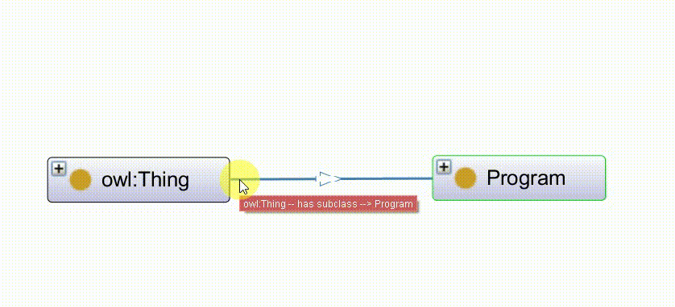
Owl Language:
To Implement Ontology
(Triples-rrdf/xml Format)

Slide 25

Protege:
Create classes
Relationships among classes(Object Properties)
Data Properties

Slide 26
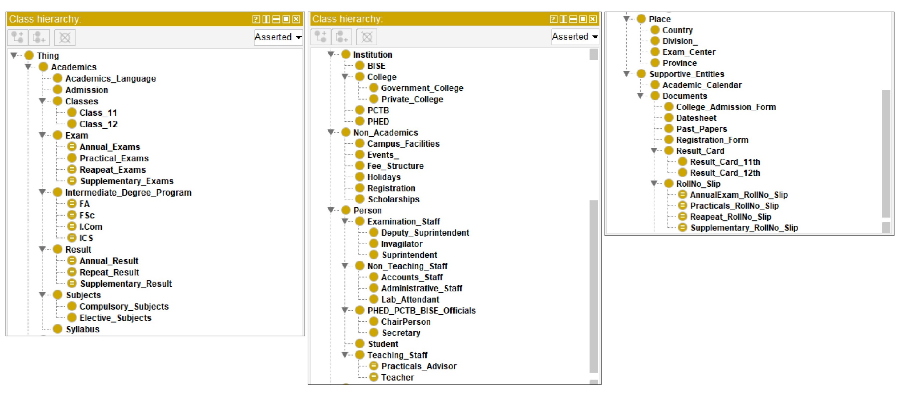
Create classes

Slide 27
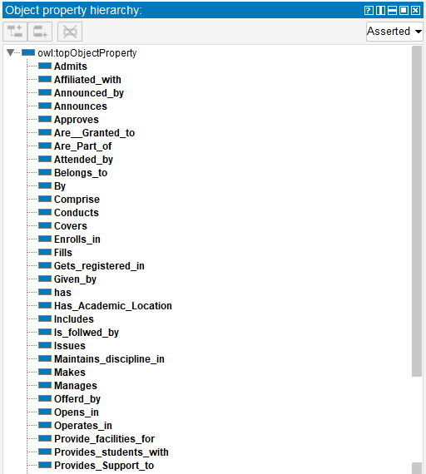
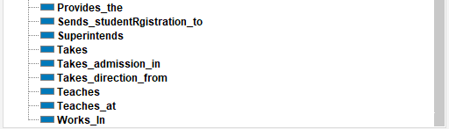
2. Object Properties

Slide 28
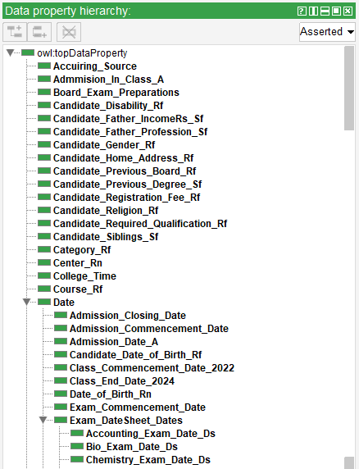
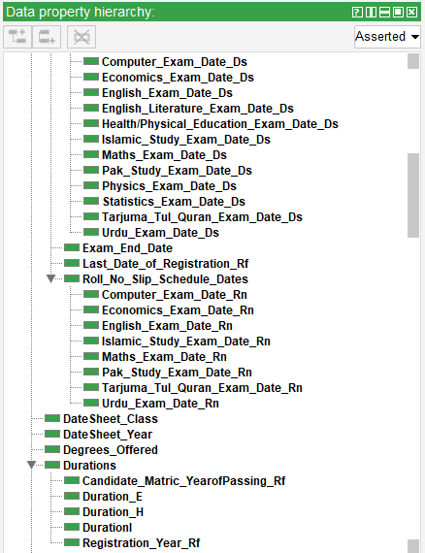
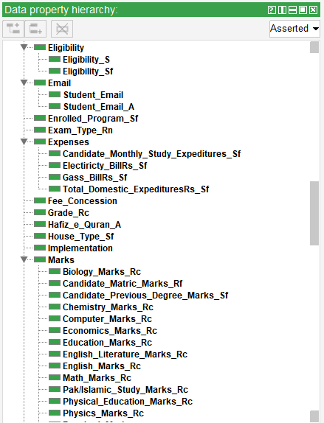
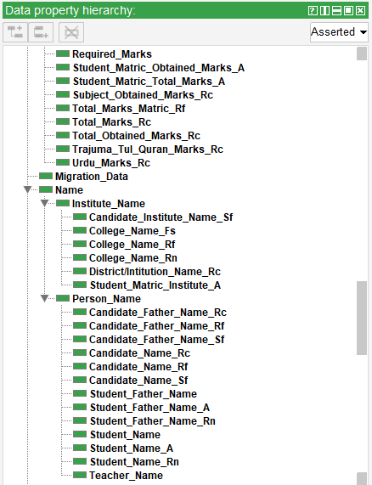
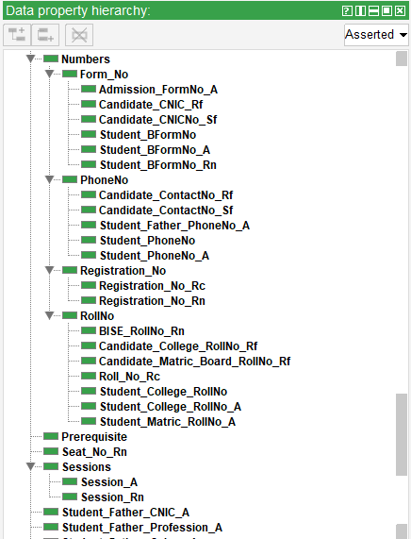
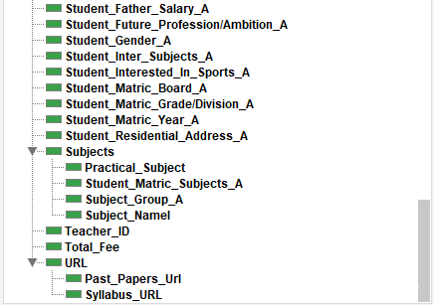
3. Data Properties

Slide 29

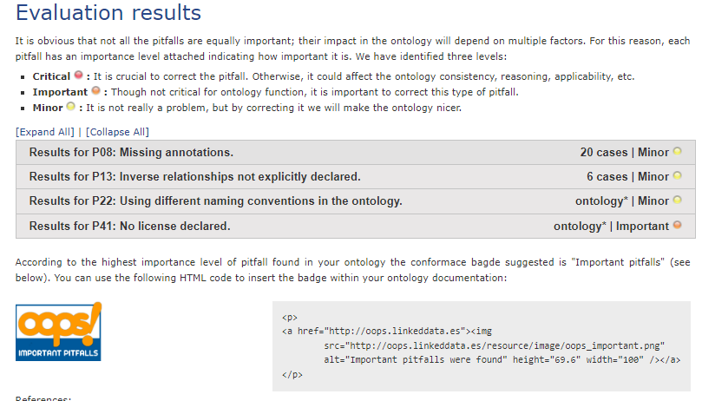
2. OOPS Pitfall Scanner:
To Evaluate Ontology

Slide 30

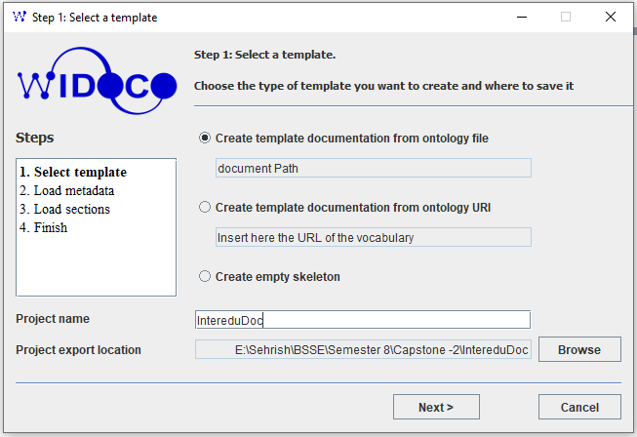
For ontology documentation.

Slide 31

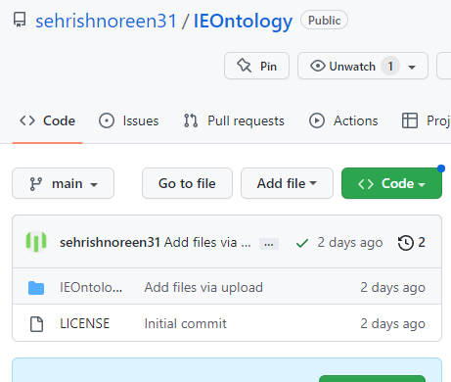
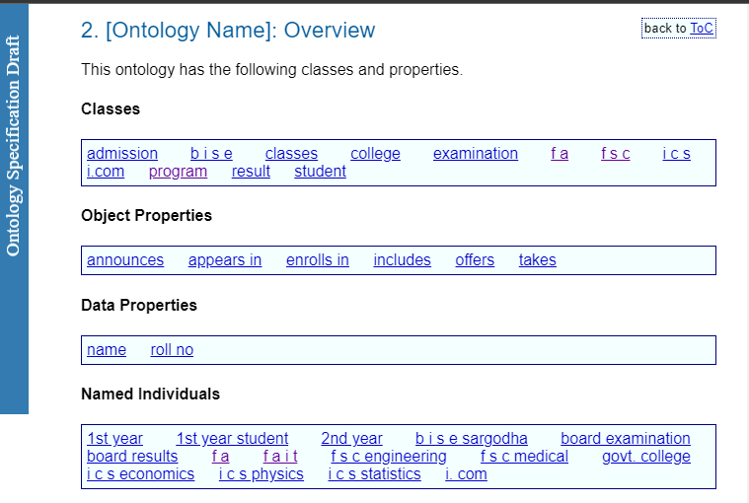

Platform for publishing the ontology Documentation.

Slide 32

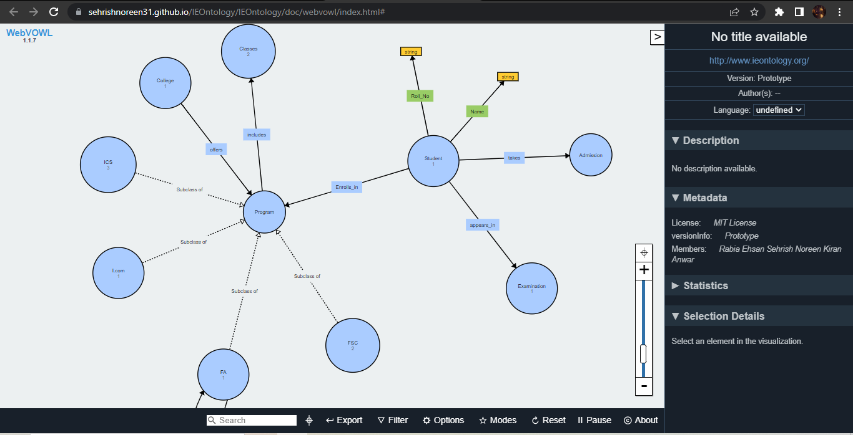
For visualization of ontology

Slide 33

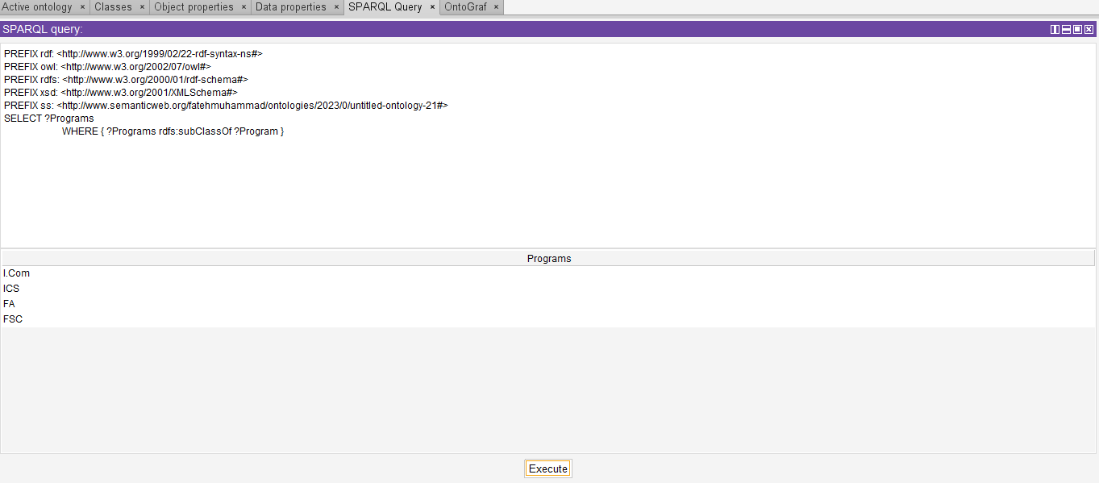
SPARQL Language to query data from the ontology.

Slide 34
End

